Slide 1
Operating Systems
SENS-3513
Week: 3
Process Management -1
Operating System Concepts
9th edition
Silberschatz, Galvin & Gagne
John Wiley & Sons
2013
Dr Nauman Mazhar
Faculty of Information Technology (FIT)
University of Central Punjab (UCP)

Slide 2
Outline
Process Management
Process vs Program
Process Control Block
Process States
(new, running, waiting, ready, terminated)
Process Scheduling Queues
Schedulers
(long-term, medium-term, short-term)
Context switching
Process related Linux commands
2

Slide 3
Process management
Multiprogramming, multitasking systems – many programs run simultaneously
  users may execute same/different programs
Fundamental task of modern OS – Process Management
  allocating resources to processes
  sharing/exchanging info between processes
  synchronization among processes
  protecting processes from one another
OS maintains various data structures :
  show state & resource ownership of process
  allow OS to implement process control
3

Slide 4
Source code, Program & Process
Source code – software appl in text form
  written in some programming language
Program
  source code in binary form – after compiling & linking
  stored in executable format – load & execute on CPU
Process – A program in execution…!!
  instance of a program running on a computer
  entity that is assigned & executed on a CPU
  each process has…
    a sequence of execution (of instructions)
    current state of process (CPU registers, etc)
    set of system resources (CPU time, memory space, files, etc)
4

Slide 5
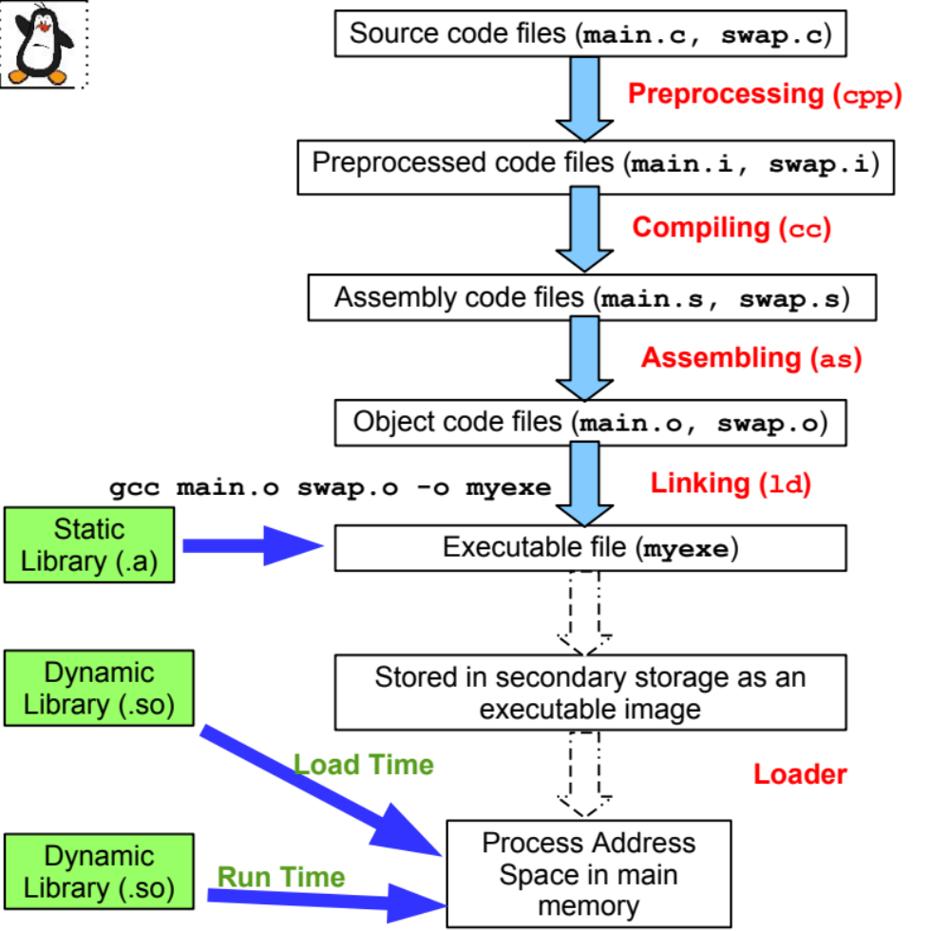
Source code compilation process
5

Slide 6
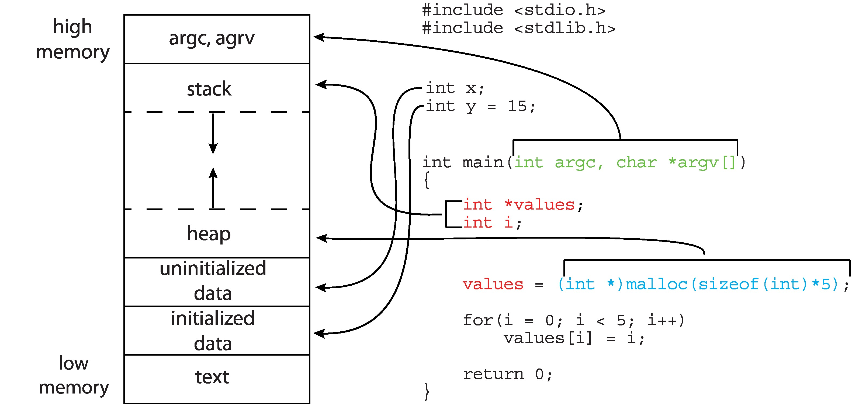
Process Address Space
6

Slide 7
Program on Disk
Program – binary file on disk, in a specific file format
Different file formats exist for various systems…
  a.out older Unix
  ELF Linux (Executable & linkable format)
  PE Windows (Portable executable)
  COFF Solaris (Common object file format)
ELF – Executable & Linking Format
  Linux / Unix file format for executables
  defines how code/data are organized in the file
  allows OS loader to efficiently load & execute programs
7

Slide 8
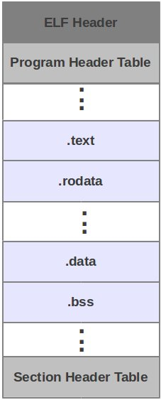
ELF File Format
.text section | contains machine code for compiled program & is read-only
.rodata section | contains read only data, like string literals & constants
.data section | contains initialized global variables
.bss section | contains uninitialized global variables
8

Slide 9
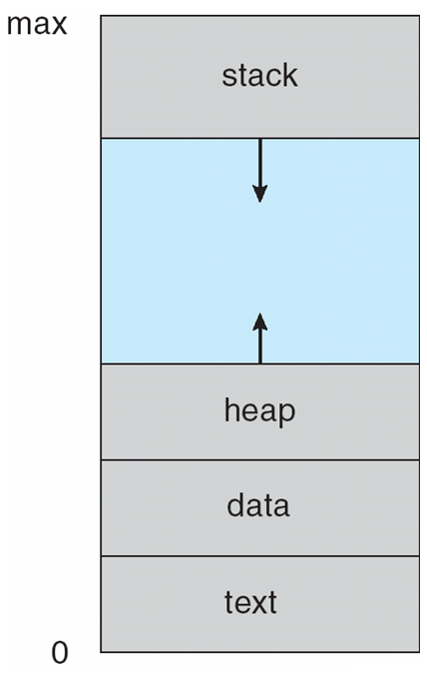
Process in Memory
Program file is loaded in memory
Only some parts of file on disk are copied to
process address space
  .text & .rodata sections copied to Text portion
  .data & .bss sections copied to Data portion
  rest of process address space created at
  run time
Process execution involves a Stack & Heap
  for procedure calls, & dynamic memory
  allocation
9

Slide 10
Process Control Block
At the top, almost 1/4th of memory address space reserved for kernel
  holds kernel code & data structures
  also has data structures for every process
An important data structure kernel maintains for every process
  Process Control Block or Task Control Block
Process Control Block
  each process is represented in OS by a PCB
  contains info required by OS to :
    control the process
    manage its resources
10

Slide 11

PCB
PCB maintains following info for each process:
Process ID
  unique ID for process
Process state
  ready, running, waiting, etc
Program counter
  address of next instruction to be executed
CPU registers (context data)
  data in processor registers while process is
  executing
  includes general purpose registers, stack pointer, etc
  state is saved on interrupt; allows to resume execution later
11

Slide 12
PCB
CPU scheduling info
  process priority
  scheduling queue pointers
Memory management info
  memory allocated to process
  base & limit registers
Accounting info
  CPU time used
  clock time since start
I/O status info
  I/O devices allocated to process
  list of open files
12

Slide 13
Process States
13

Slide 14
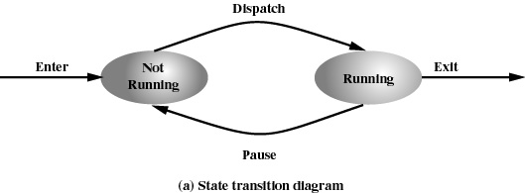
2 State Process Model
Simplest model
When new process is created, OS creates a PCB
  process state → Not Running
If CPU available, process dispatched for execution → Dispatcher
  process state → Running
  (at any given time, only one process in Running state)
Wait for I/O
14

Slide 15
2 State Process Model
If running process has to wait for I/O completion
  process interrupted → Dispatcher
  switched from Running to Not Running state
If system has additional processes awaiting execution
  another process selected to run → Process Scheduler
Wait for I/O
15

Slide 16
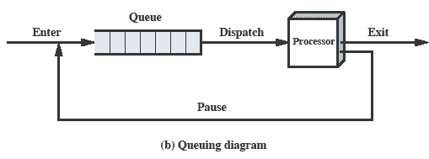
Queuing Diagram
Queuing structure for two state process model…
  queue is a linked list of PCBs
  queue header has pointers to first & last PCB in list
  each PCB includes pointer to next PCB
  selection of process to run based on → Round Robin
16

Slide 17
Queuing Diagram
This queuing discipline works fine, if all processes in queue are always ready to execute
  “but some processes in queue might be blocked”
  1. Waiting for an event to occur
  (created a child process & waiting for it to return result)
  2. Waiting for shared resource, not available at this time
  (disk busy with I/O request of another process)
  3. Process gone to sleep for some time
  “Scheduler/dispatcher has to scan
  complete list of processes, for one not blocked”
17

Slide 18
5 State Process Model
Five State Model – caters for processes that are not ready to execute
  Not Running state split into two → Ready & Waiting
  Two additional states → New & Terminated
  New : process created, not yet in memory
  Ready : process in main memory, awaiting processor
  assignment
  Running : instructions being executed
  Waiting : process waiting for some event to occur
  (I/O completion, or reception of a signal)
  Terminated : process finished execution
18

Slide 19

5 State Process Model
19

Slide 20
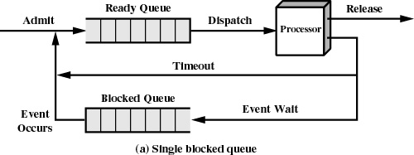
Queuing Diagram - using 2 queues
Limitation – when an event occurs
  dispatcher has to cycle thru entire Blocked Queue
  (to find process waiting for that event)
    can be huge overhead for 100’s or 1000’s of processes
    Use multiple “Blocked Queues”
20
Notes:
In the simplest solution, this model would require an additional queue for the blocked processes.
But when an event occurs the dispatcher would have to cycle through the entire queue to see which process is waiting for the event.
This can cause huge overhead when their may be 100’s or 1000’s of processes

Slide 21
Process Scheduling Queues
Job Queue
  when a job is created, it is placed in Job Queue on disk
  waits to be admitted into main memory for execution
Ready Queue
  consists of processes residing in main memory
  ready & waiting to be executed
Device Queues
  list of processes waiting for a particular I/O device
  each device has its own device queue
“during process life-time,
it migrates from one queue to another”
21

Slide 22
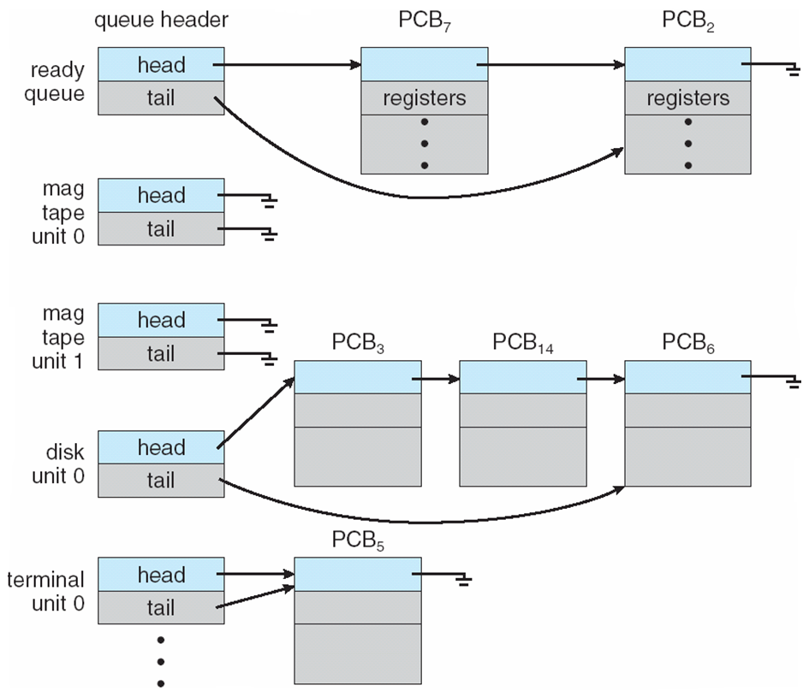
Ready Queue & I/O Device Queues
when process is not running,
PCB is in some queue
separate queue for each device
each queue can have different scheduling policy
22

Slide 23
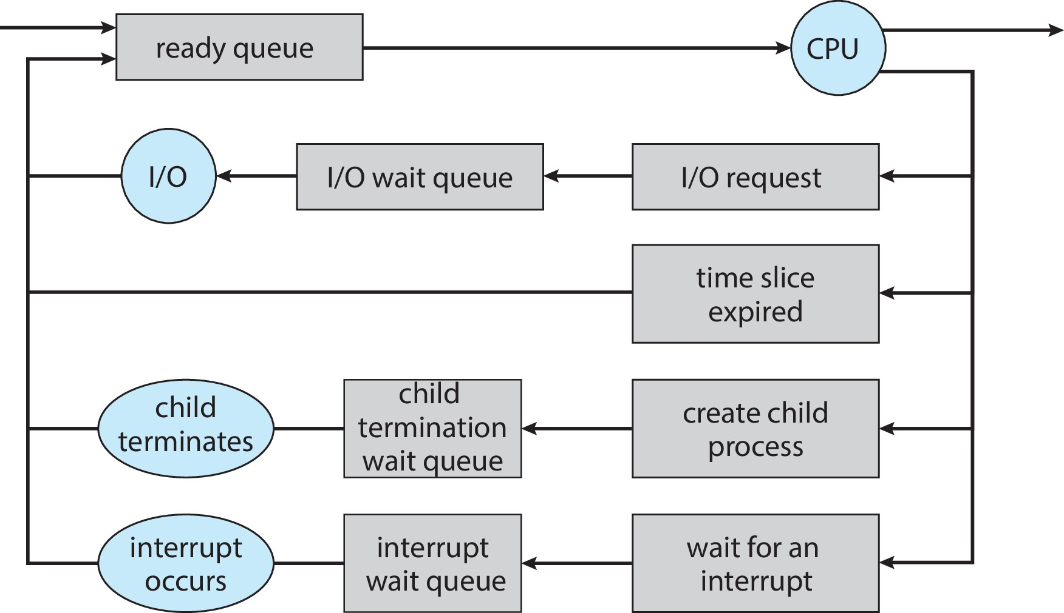
Queuing Diagram
23

Slide 24
Schedulers
24

Slide 25
Schedulers
A process migrates between various queues during its life cycle
Schedulers needed to select processes from queues, as per
some scheduling criteria
“Scheduling is concerned with management of queues;
objective is to minimize queuing delay,
& optimize performance”
OS uses three types of schedulers:
  Long term scheduler
  Short term scheduler
  Medium term scheduler
25

Slide 26
Long Term Scheduler
Long-term Scheduler (job scheduler)
  selects processes from job queue (processes spooled on hard disk)
  brings into ready queue (inside main memory)
Used mainly in batch systems
  timesharing OS has no long-term scheduler
Long-term scheduler invoked infrequently (secs, mins)
  batch jobs run for long time – new jobs less frequent
  high overhead to load jobs from disk to memory
Long-term scheduler controls degree of multiprogramming
  how many jobs are resident in memory – memory size
26

Slide 27
Process Types
Process lifetime comprises CPU bursts & I/O bursts
CPU Bound Process
spends more time on computations – Long CPU bursts
apps with mathematical computations, digital signal processing
CPU Burst
I/O
CPU Burst
I/O
I/O Bound Process
spends more time on I/O – Short CPU bursts
copy large files, streaming media Apps, billing system having printing
I/O Burst
CPU Burst
I/O Burst
CPU Burst
27

Slide 28
Long Term Scheduler
Long Term Scheduler must select a good mix of I/O bound &
CPU bound processes
  If all selected processes are I/O bound
    Ready Queue will almost always be empty
  If all selected processes are CPU bound
    I/O Waiting Queues will almost always be empty
28

Slide 29
Short Term Scheduler
Short-term Scheduler (CPU/Process scheduler)
  decides which process runs, when, & for how long
  invoked frequently (milliseconds) → must be fast
Invokes context switch, or process switch
  saves → state of currently running process
  loads → saved state of the selected process
Scheduler invoked when following events occur…
  CPU time slice of current process ends
  process blocks waiting for I/O
  process terminates, or sleeps
  interrupt occurs
29

Slide 30
Need for Swapping
An issue:
  all processes in memory may be in blocked state
  new process wants to execute
  memory not available
Solution – “Swapping”
  Swap out :
  – move some process from memory to disk
  Swap in :
  – bring a new process from disk to memory
30

Slide 31
Medium Term Scheduler
Medium Term Scheduler (Swapper)
  select an in-memory process
  suspend the process – change state from blocked to suspend
  swap out → suspended process
  swap in → new process
Swapping decision may be needed when…
  system needs to improve process mix
  higher priority process arrives, but no memory available
  memory requirement of a process selected for execution
  can’t be met
Blocked state becomes Suspend state,
when process swapped out
31

Slide 32
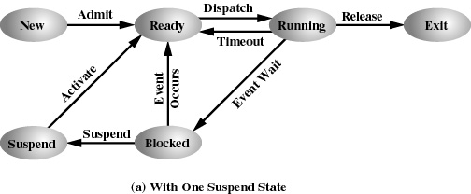
6 State Process Model (one suspend state)
Limitation: Only allows blocked process to swap out; what if no blocked process, but still need memory
Solution: Add another state Ready Suspend, and swap out a process from Ready state
32
Notes:
Again, the simple solution is to add a single state – but this only allows processes which are blocked to be swapped out.

Slide 33
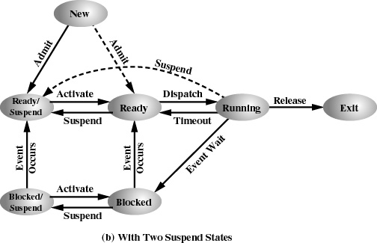
7 State Process Model (two suspend states)
Suspend state split into two:
Ready Suspend & Blocked Suspend
33
Notes:
Two suspend states allow all processes which are not actually running to be swapped.
Run through the four states:
Ready: The process is in main memory and available for execution.
• Blocked: The process is in main memory and awaiting an event.
• Blocked/Suspend: The process is in secondary memory and awaiting an event.
• Ready/Suspend: The process is in secondary memory but is available for execution as soon as it is loaded into main memory.
It would be useful to also summarise the main transitions
Blocked → Blocked/Suspend: If there are no ready processes, then at least one blocked process is swapped out to make room for another process that is not blocked. This transition can be made even if there are ready processes available, if the OS determines that the currently running process or a ready process that it would like to dispatch requires more main memory to maintain adequate performance.
Blocked/Suspend → Ready/Suspend: A process in the Blocked/Suspend state is moved to the Ready/Suspend state when the event for which it has been waiting occurs.
Ready/Suspend S → Ready: When there are no ready processes in main memory, or if a suspended process has a higher priority, the OS will need to bring one in to continue execution.
READY → READY/SUSPEND: Normally, the OS would prefer to suspend a blocked process rather than a ready one, because the ready process can now be executed, whereas the blocked process is taking up main memory space and cannot be executed. However, it may be necessary to suspend a ready process if that is the only way to free up a sufficiently large block of main memory.
Several other transitions that are worth considering are the following:
New → Ready/Suspend and New →Ready: When a new process is created, it can either be added to the Ready queue or the Ready/Suspend queue. In either case, the OS must create a process control block and allocate an address space to the process. It might be preferable for the OS to perform these housekeeping duties at an early time, so that it can maintain a large pool of processes that are not blocked. With this strategy, there would often be insufficient room in main memory for a new process; hence the use of the (New → Ready/Suspend) transition.
Blocked/Suspend → Blocked: Inclusion of this transition may seem to be poor design. After all, if a process is not ready to execute and is not already in main memory, what is the point of bringing it in? But consider the following scenario:
A process terminates, freeing up some main memory.
There is a process in the (Blocked/Suspend) queue with a higher priority than any of the processes in the (Ready/Suspend) queue and
the OS has reason to believe that the blocking event for that process will occur soon.
Under these circumstances, it would seem reasonable to bring a blocked process into main memory in preference to a ready process.
Running → Ready/Suspend: Normally, a running process is moved to the Ready state when its time allocation expires. If, however, the OS is pre-empting the process because a higher-priority process on the Blocked/Suspend queue has just become unblocked, the OS could move the running process directly to the (Ready/Suspend) queue and free some main memory.
Any State → Exit: Typically, a process terminates while it is running, either because it has completed or because of some fatal fault condition. However, in some operating systems, a process may be terminated by the process that created it or when the parent process is itself terminated. If this is allowed, then a process in any state can be moved to the Exit state.

Slide 34
Context Switching
34

Slide 35
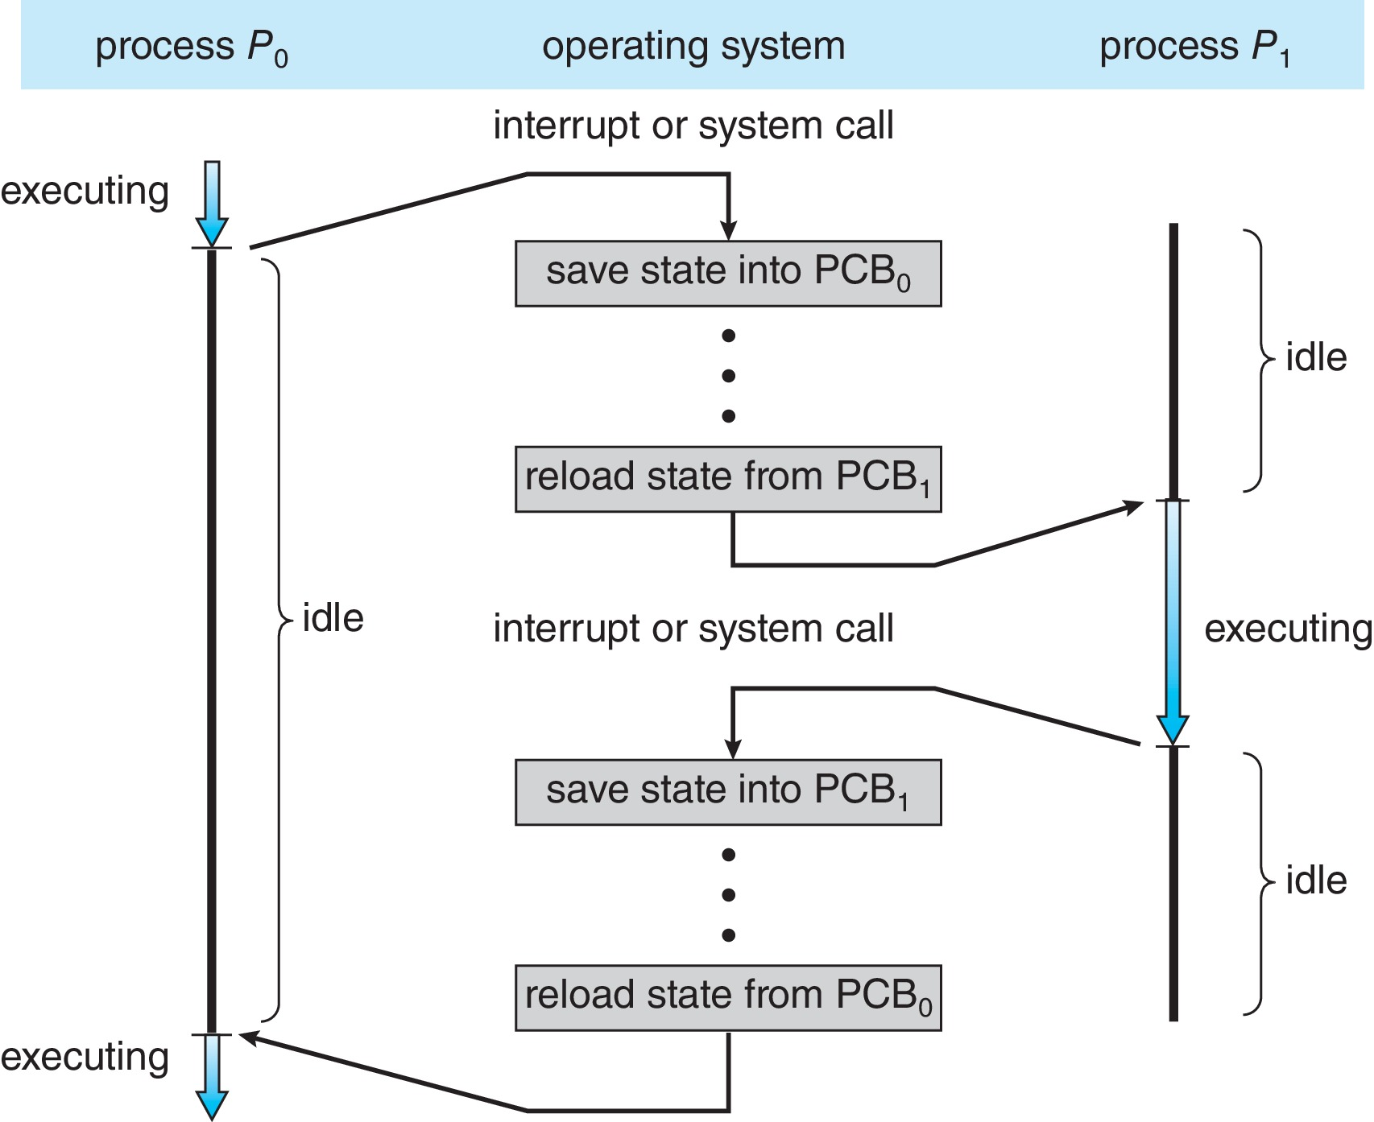
Context Switch / Process Switch
Context switch occurs when CPU switches from one process to another
35

Slide 36
Context Switch / Process Switch
When CPU switches to another process, system must…
  Save state → state (context) of current process
  Load state → saved state for the new process
Context switch time is overhead
  system does no useful work while switching
Process switch is mainly performed by Dispatcher
  scheduler → only selects the process to be switched
  dispatch latency → time it takes for dispatcher to stop one process
  & start another
Process switch triggered by…
  interrupt, system call, exception, system timer, or signal
36

Slide 37
Context Switch / Process Switch
Steps involved in Process switch:
  Change CPU mode to Kernel
  Save context of currently running process in its PCB
    including contents of PC, SP, CPU registers, & process state
    updated PCB is moved to an appropriate Queue
  Select another process for execution (Process Scheduler)
  Update PCB of selected process
  Restore the context of selected process
    PC, SP, CPU registers from its PCB
    update memory management data structures
  Change CPU mode back to User
  Transfer control to new process
37

Slide 38
Context Switch - Examples
Time-Sharing
when time slice allocated to a process expires, OS switches to another ready process
Priority Scheduling
if higher-priority process becomes ready to run, CPU is given to the most important task
I/O Operation
when a process starts an I/O operation (read from disk, or receive data from network), and has to wait for I/O completion, OS lets another process use CPU
38

Slide 39
Context Switch - Examples
System Call
when a process makes a system call (file I/O, memory allocation, creating new process), OS performs a context switch, to change from user to kernel mode, and service the system call
Interrupt Handling
if H/W interrupts occurs (keyboard input, disk activity, network packet receival), CPU switches from current process to an ISR to handle the interrupt
Process Termination
when a process completes execution, or is terminated due to error or user action, context switch allows to run the next process in queue
39

Slide 40
Context Switch - Examples
Process Creation
when a process is created, context switch occurs as OS initializes and sets up the new process for execution
Sleeping Process
if a process enters sleep or wait state (wait for a specific event, or semaphore) context switch frees the CPU for another process
Exception
hardware exceptions, like division by zero, invalid memory access, or illegal instruction, requires a context switch to handle the error
40

Slide 41
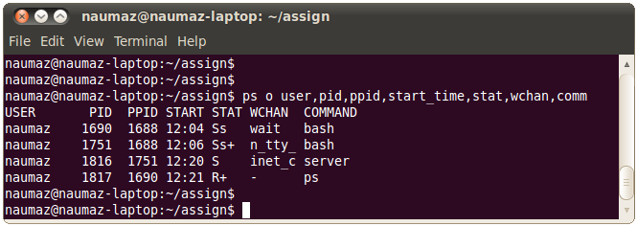
Linux Commands - view processes
Process Status (ps)
most commonly used shell command to display info about running
processes
$ ps [auxl]
R running S sleep
s session leader + foreground
41

Slide 42
Linux Commands - view processes
Top - another command used to display real-time information about running processes
  by default, refreshes o/p every three seconds
  displays summary area (about 6 lines of info)
  also displays per process info area (about 12 columns)
  interactive command, with important keys as:
    n : prompts for number of processes, to display
    u : prompts user name, whose processes to be displayed
    s : prompts number of seconds, to refresh display
    r : prompts PID & nice value, to be changed
    k : prompts PID & signal, to be sent to process
(see details on man page of ps & top)
42

Slide 43
Process Related UNIX Commands
Command | Description
# ps [auxl] | Display status of processes
# top | Display information about top 20 processes
# vim file1.txt & | Running a command in back ground
CTRL + Z | Suspend foreground process to go back to shell
# jobs | Display status of suspended and background processes
# bg %job_id | Put process in background
# fg %job_id | Move background process to foreground
CTRL + C | Kill foreground process
# kill [-signal_no] proc_list | Send signal for signal_no to processes whose PIDs or jobIDs are specified in proc_list. jobIDs must start with %.
43
Notes:
-a: displays information about the processes executing on your terminal except the session leader (your login shell)
-e: display info about all the processes running on the system
-l: display long list (14 columns) of the status report
-u uidlist: display info about processes belonging toe the users with the UIDs in comma separated uidlist
State : I, R, S, T U, Z
Daemon is a system process running in the back ground, e.g., lpd, fingerd, inetd,
The primary purpose of kill command is to send a signal / software interrupt to a process.
Commonly used signal numbers:
-1: Hang up signal is generated when you log out
-2: Interrupt signal is generate when you press CTRL + C
-3: Quit signal is generated when you press CTRL-\
-9: Sure kill
-15: Software signal ( default signal number)

